Slide 1
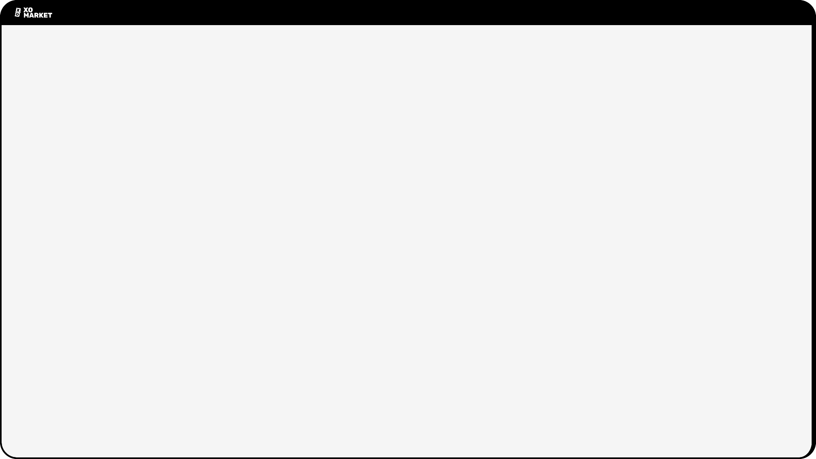
XO Market - First 90-Day Marketing Impact Report
Summary
Objectives
Funnel
Key Initiatives
Budget
Growth Metrics
Next Quarter
Prepared by: Jay Mehta, Marketing Lead
Date: 11.07.2025

Slide 2
Summary
Goal
Demonstrate achievements of the first 90-day period marketing objectives and early traction leading up to Phase 1 of XO Market Alpha.
Highlights
Built an end‑to‑end acquisition funnel that moves users from first impression to first trade.
Scaled an active community hub on Discord and Zealy, supported by recurring quests, gamified leaderboards and a weekly Creators Program.
Landed a 12-month deal with Customer.io at $0 cost to the company, saving upwards of $6,000.
Migrated + initial segmentation email database from legacy to dynamic.
Implemented an automated waitlist response & invite‑code CRM flow that delivers frictionless onboarding.
Launched a multi‑channel content engine spanning X/Twitter, substack, medium, reddit that emphasises brand positioning & narrative building.
Ran conviction‑themed engagement campaigns that reinforce XO’s core narrative.
Activated an ecosystem partnership with Mad Scientists being the first.

Slide 3
Objectives & KPIs
Objective | KPI
Awareness | Twitter followers (Net new)
Community | Discord members (Net new)
Engagement | Zealy participants
Lead capture | Mailing‑list sign‑ups
Activation | Active platform users (30‑day)
Stickiness | Top Funnel to Platform Sign-up Rate

Slide 4
Funnel
AWARENESS/
IMPRESSIONS
COMMUNITY/
INTENT
ACTIVATION/
CONVERSION
LOYALTY/
STICKINESS
Zealy Quests
Guerilla Marketing
Co-Marketing promos + Giveaways
Organic Twitter
X/Twitter
Discord
Creators Program
Waitlist sign-ups
Invite Activations
Roles
Alpha sprint participation
Alpha platform sign-up
First trades
Recurring trades
CP Claims
> ADVOCACY

Slide 5
Key Initiatives Shipped
Zealy Onboarding
Creators Program
(content community)
Guerilla Campaign
Customer.io migration & waitlist automation
Sprint to Alpha
MadSci Partnership
Mammoth NFT Giveaway
Invite‑code Distribution
Scalable
Narrative Building
Upcoming campaign designs - Talk is Cheap, Popular personality quotes
Drip Content Flow
Mini-app Drip Content & Reward Distribution
KOL Outreach (ongoing)

Slide 6
Marketing Spend
Channel/Activity | Cost
Zealy | $200 + $249 = $449
Giveaway Campaign | $1,000
Customer.io | $0
…
Total | $1,449

Slide 7
Growth Captured
Metric | 0-Day | Result | % increase
X Followers | ~600 | ~10,500 | +1,650 %
Discord Members | 0 | 2,362 | -
Zealy | 0 | 2,777 | -
Mailing list | 185 | 5,205 | +2,714 %
Closed Alpha Users | - | 300+ | -
CAC (Lead) | 0 | $0.29 | -

Slide 8
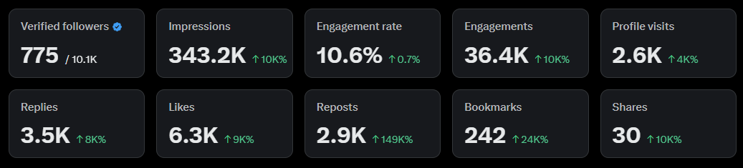
Twitter Focus

Slide 9
Next Quarter
Talk is Cheap
Campaign Launch
KOL Campaigns
Creation of Community Spaces On XO Platform
Ads
10k Platform Sign-ups
XO Ambassadors Program
More Community Partnerships
Co-marketing Campaigns
CRM Customer Journeys and Retention Campaigns
Alpha, Beta & Mainnet Launch Campaigns
Content Pipelines
Unifying XO Gamification x Community Campaigns

Slide 10
Thank You

